Slide 1
Impact of Data Mining on OTT platforms
Aditya Agre
Pranjali Deshpande
Mansi Ahir
Prof. Dinesh Kute

Slide 2
1. Abstract
The recent times have witnessed a major turnaround in the entertainment industry. Traditional television systems are slowly losing viewership, while online streaming platforms are booming. There have been large scale movements in show businesses, advertisement industries, content genres, etc. Various forms of data analysis have been widely used for predictive analysis and for advertisements. Over the course of this paper, we have made an attempt at understanding the performance and significance of data mining techniques in the modern day show business.

Slide 3
2. What are OTTs
Over the top TVs, better known as OTTs are internet-based video content streaming platforms. They are subscription-based websites that provide access to film and television content. These services can be accessed through a multitude of gadgets ranging from cell phones to computers via the internet.

Slide 4
Users are offered a wide spectrum of genres and languages in movies and series to choose from. Viewers can choose between live streaming shows or previously streamed shows. OTTs, in most cases, also possess exclusive broadcasting rights, capturing the market in various genres. With the rise in internet availability and the cell phone culture, content consumption has transformed. Large percentages of viewers have shifted from traditional televisions to various OTT platforms. The total OTT audience in India is presently estimated to be 35.32 crore, translating to a penetration rate of 25.3 percent, implying that one in every four Indians watched online videos at least once in the previous month.
OTTs can be broadly classified into two categories by The United States Federal Communications Commission.
Multichannel video programming distributers (MVPD)
Online video distributers (OVDs)

Slide 5
Since OTTs are the buzz-words right now, people have collections of platforms to choose their desired movies, series, etc. Currently the leading OTT platforms in India are:
Hotstar (41%)
Euros Now (24%)
Amazon Prime Video (9%)
Netflix (7%)
Zee5 (4%)
Amongst audio platforms:
Gaana (30%)
JioSaavn (24%)
Wing Music (15%)
Spotify (15%)

Slide 6
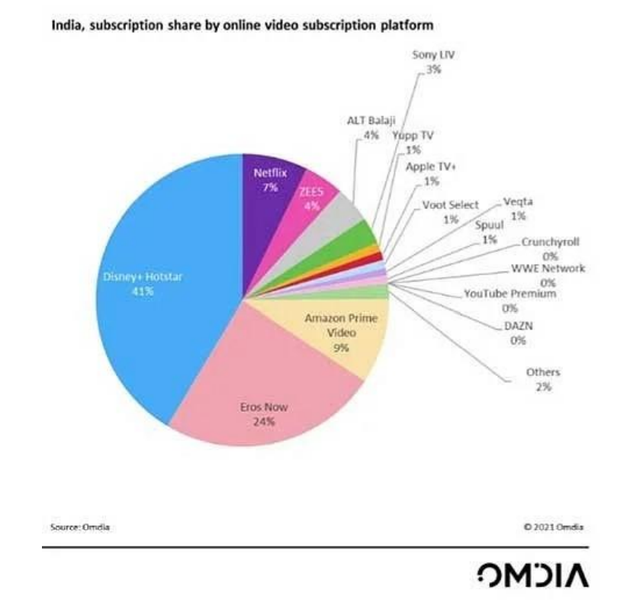

Slide 7
3.Advent of OTTs
OTTs cater to the diverse viewing interests of viewers that traditional televisions could not. These websites serve choices to the consumers according to their needs, making them avoid unnecessary payments. On the other hand, consumers have to pay for company offered channel plans on traditional televisions, making them pay for channels they never use. With the video on demand in the picture, the viewers can enjoy the membership which fits in their interests, at any time and place.

Slide 8
Over the top televisions add viewing alternatives to the consumers which gives diversity in viewing options, subscription costs at affordable rates. Most cable subscriptions are made for a single television, forcing watch parties to choose one single viewing option. However, most OTT subscriptions can be accessed via multiple devices from the same account. One can enjoy the perks of watching OTT in a group, without physically being there, through the internet.

Slide 9
4. What is data mining
Data mining, bluntly, refers to the recognition, analysis and application of patterns amongst datapoints in different datasets. Data mining is also known as knowledge discovery in data.
Initially, the term used was practical machine learning, however, for better marketing prospects, it was renamed to ‘Data Mining’. In recent years, terms like Data Analysis (large scale) and Analytics are used for convenience while referring to actual methods, artificial intelligence and machine learning are considered as the better alternatives.

Slide 10
Datapoints may range from graphs, images, mathematical statistics, customer behaviour patterns, mixed visuals, etc. It has grown to become an important subset of machine learning. With rapid developments in data warehousing techniques, data miming techniques have been widely implemented in various fields. It covers the areas of semi-automatic and automatic analyses of textual databases.
Data mining has proved to be invaluable in organizational decision making by using data analyses techniques. These methods are divided into two parts:
• They can be used to explore and map the target dataset. This makes analysis and navigation through the data easier.
• They can be used to predict the outcomes through machine learning techniques.

Slide 11
5. Collection of data
OTTs have two main objectives to track customer data:
1. Improved customer recommendations:
Over a period of time, audiences’ interests have changed, which has made a huge difference in streaming behaviour. Now we have multiple online streaming platforms like Amazon prime video, Netflix, Disney, Hotstar, TVF, YouTube, etc. With an overabundance of information, it is important to use the correct data using proper data mining techniques. This should be implemented in such a manner that a customers get new, improved and improvised suggestions and recommendations. Thus, it helps in gaining a much larger interest from the customers in the product or service as they find it non-repeating and novel.

Slide 12
2. Personalized advertisements:
The advantages of data mining are multifold. Various companies and advertising giants invest to run multiscreen ad campaigns which are implemented with the help of various programs and algorithms to target customers according to their interests with a personalized marketing plan. This saves advertisers from spending large sum of money targeting specific audiences as opposed to displaying the same advertisements to all the audiences at large. Since the advertisements that are run are precise, the number of devices they are displayed on decreases significantly, making advertising cost effective.

Slide 13
The OTT industry was worth $121.61 billion in 2019 and is expected to go up to $1.039 trillion by 2027. 51.58% of OTT revenue comes from advertising video-on-demand.
Programmatic impressions of marketing campaigns increased by 207% on connected TVs in the USA.
When watching OTT content, 40% of viewers have paused what they were watching to go online and check out or even purchase what was being advertised to them.
Advert recall is strong with OTT viewers; 72% of them could remember a specific ad they were served whilst watching.

Slide 14
The major ways of collecting personal data are:
1. Customer data:
This sector covers datapoints regarding the user’s personal information. This includes age, gender, vocation, geographic location, etc. Demographic analysis, which is predictions based on general trends across a certain geographic zone or a community, are widely used. Data can also be outsourced from other websites such as search engines, web browsers, online shopping platforms, etc. This includes internet behaviour patterns, browsing history, purchase history, etc.

Slide 15
2. Content data:
When a user browses a webpage/website, the content of the webpage, search keywords, video play stats which includes finished and watch time, devices used, watch content, video views, everything is analysed on the principle of Content Targeting. This content data is compared with the content of the ad libraries and appropriate advertisements are pushed to the user.
3. Sales Data:
It's crucial to focus on sales data, it being the most valuable information for OTT. OTTs study their own sales statistics in order to target the users/viewers based on real-time site traffic, growth metrics, conversion rate, customer churn, popular products by region. This sales data helps improving the content suggested to the viewers and also it majorly uplifts OTT Platforms' sales and income graphs.

Slide 16
6. Managing Data in OTT
As there is an increase in technology and entertainment, data mining plays a huge role in today’s fabrication. Data management considers terms of roles and responsibility in the management system. The data is saved in data warehouse efficiency, data lakes, securely and reliably. Data mining investigates and studies new perceptions with analytics, including graphic and image analytics, and uses artificial machine learning and visualization to create models. Data management in OTT’s dominates over audience’s content, user experience, brand, monetarization and most of all. The software also manages the information that explores about the audience’s feed and this big data to recommendation engines and ad services. This process requires real time analysis and fast inspection of the data user along with presentation of search to the user in engaging manner.

Slide 17
7. Effects of Data Mining on OTTs
OTT giants have been working on their customer behaviour and interest predicting algorithms for more than a decade now. It’s no surprise that the effects of these algorithms have begun to show. The predicting algorithms are so accurate now, that even if users aimlessly log on to the OTT platforms, they would still find something of their interest on their recommendations page. The Customer data analysis is also proving to be very useful in the advertisement industry. Major companies are now changing their marketing budgets and shifting them towards online advertisements. These funds, are mostly drawn from the television advertisement budgets. The total OTT revenue is predicted to jump 53% by 2025, totaling $272 billion.

Slide 18
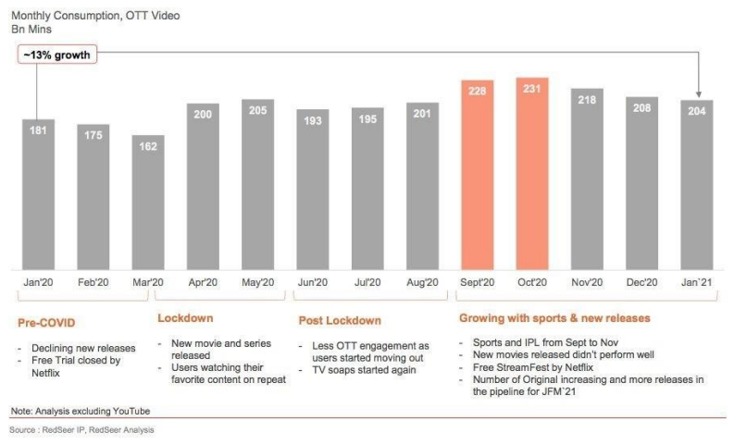
42% of US agencies and marketing professionals expect to up their advertising spending on OTT platforms in 2021.

Slide 19
For example, data mining tools like Graph API and REST API provided by Facebook and Twitter respectively, have made it easier to comprehend a viewer as they are tied into OTT services. Information regarding the users is integrated into data pools which can be used by data analysing systems. Result, specifically designed marketing and advertising campaigns can be directed to individuals according to their viewing patterns.

Slide 20
8. Potential of Data Mining in OTTs
In today's progressive and flourishing world, with rapid development in age of technology, OTT is the recipe of success. When it comes to entertainment and binge watching, proliferation of the digital tradition has completely changed. OTT has become a regular part of our vocabulary where the market is all set to explore. Personalization streaming is implemented in its place at the heart of content services. Observing the OTT market maturing, data mining plays an important role in this competitive industry. Data Mining and Analytics can change the world of OTT. While inculcating Data Mining, it gives opportunity to make an actionable difference in learnings of customer behaviours and managing business rules.

